Slide 1
MJ² Robotics
Maryam Abdul-wahid, John Gentry, and Jacob Dorer

Slide 2
Designing a better future for cyborg-kind.

Slide 3
Ariadne’s Achievements
Design features that make Ariadne raise above the rest.

Slide 4
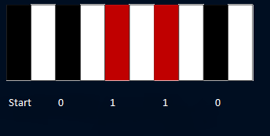
Requirements
Robot shall:
follow black line to end point, turns around and returns to starting point
read and display binary information from barcodes on LCD
run using a wired controller

Slide 5
Proposed Design
Hardware
software
Basic Robot Build
IR transmitters and receivers
Wired controller
H-Bridge
Joystick
Line following algorithm
Bar code reader
State machine for joystick

Slide 6
Hardware Diagram

Slide 7
Software Diagram - Line Following

Slide 8
Software Diagram – Barcode Reader

Slide 9
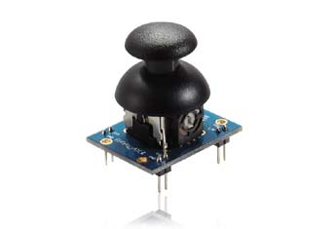
Step A
Parallax joystick
Wired controller
Cable and connectors

Slide 10
System Build and Test
Build and Design
Testing
Develop an line following software and hardware
Bar code reading software
Construct controller/joystick unit
Adjusting trim to allow for optimal line following
Practice driving over and scanning bar codes
Auto-calibration for IR receivers and motor control
Run robot out of autonomous mode/control mode

Slide 11
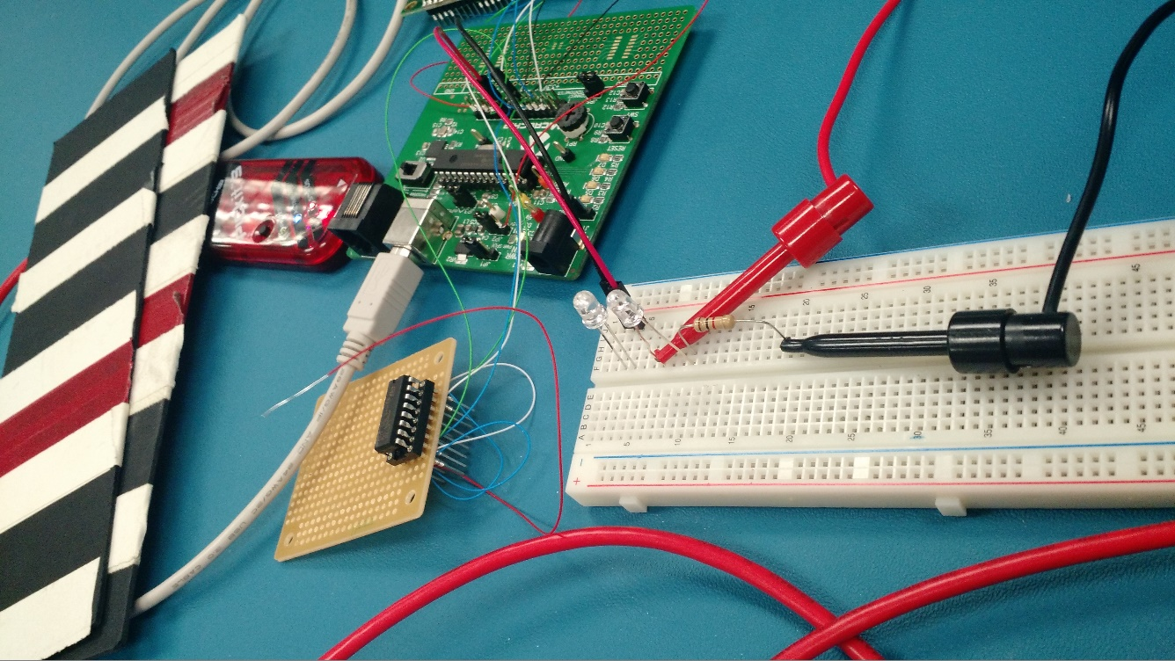
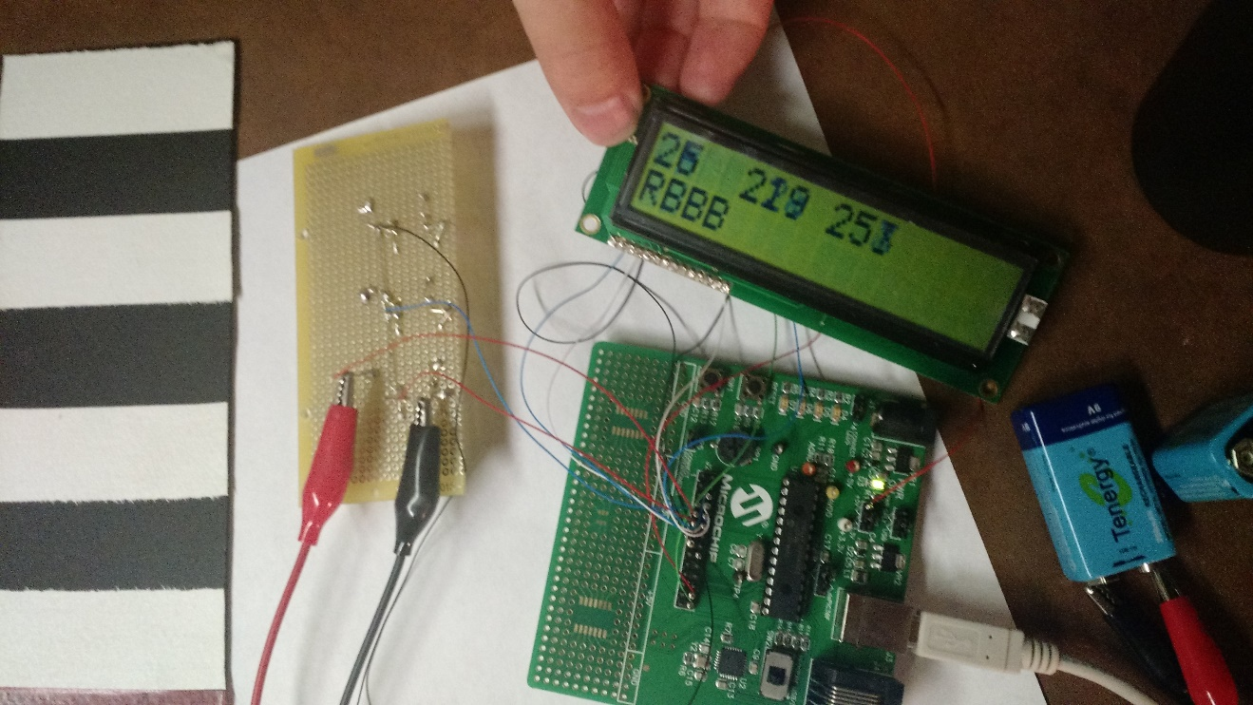

Slide 12
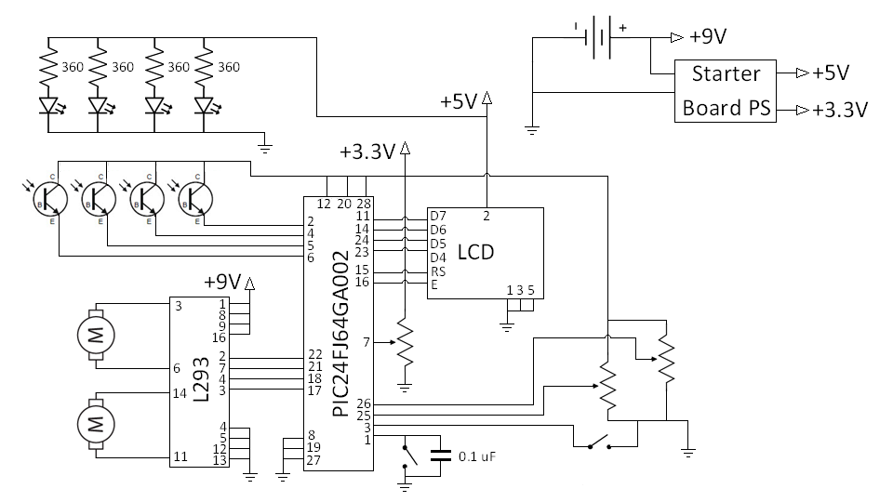
Electrical Schematic

Slide 13
Task Responsibility
Maryam
Design Lead
Design system functionality
John
Hardware Lead
Design circuit layout
Jacob
Software Lead
Design software architecture
Test and maintain software update
Implement hardware structure
Implement system design

Slide 14
Timeline

Slide 15
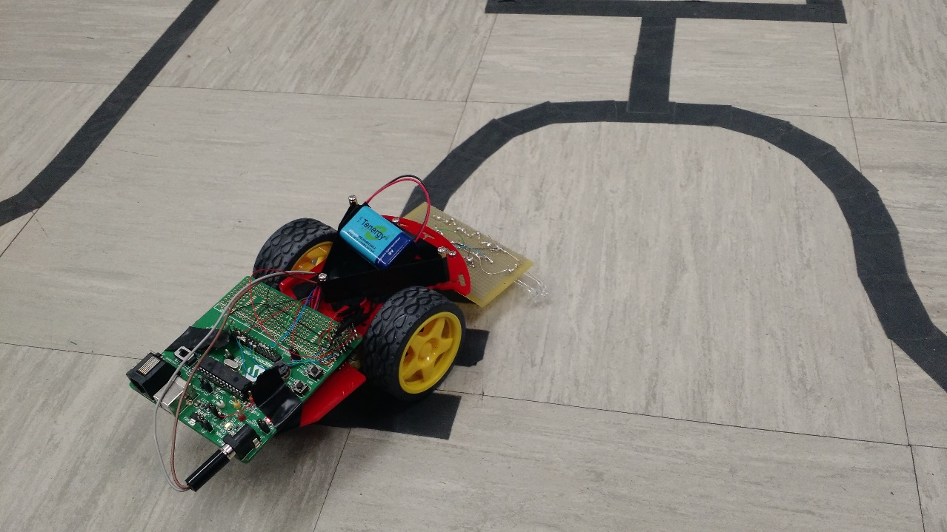
Deliverables
PDR and CDR
Demo
Able to follow lines on the ground
Possibility of using similar technology for other applications(i.e. following scents, light, or radiation trails)
Able to read binary input
Useful for relaying information to the robot
Implementation of secondary input mode in future design
Able to auto-calibrate IR sensors and motor controller speed
Step A
Handheld wired controller
Cabling
Final Report

Slide 16
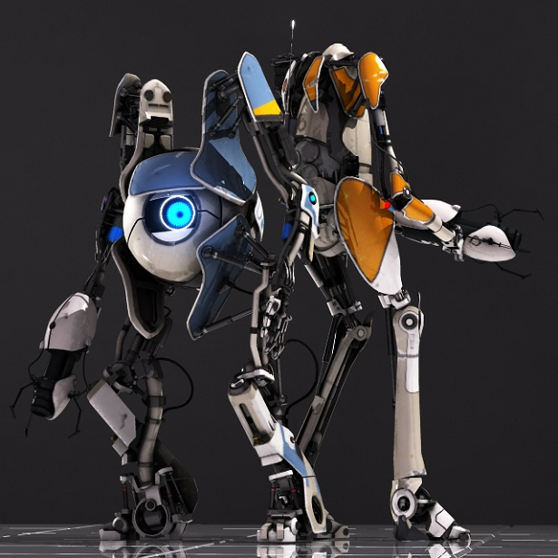
MJ² Robotics
Designing a better future for cyborg-kind.
Photo property of Valve Corporation (not our real robots…yet)

